Slide 1
Infosys Springboard Internship
Hate Speech Detection in Twitter Platform
By Arkdip Ghosh

Slide 2
Content :
SL. No | Topic Name | Page no
1. | Business Problem | 1
2. | Proposed Solution | 2
3. | Dataset Description | 3
4. | Data Distribution | 4 – 5
5. | Data Preprocessing | 6
6. | Tokenization and Embedding Techniques | 7
7. | Modeling | 8 – 10
8. | Evaluation Metrics | 11

Slide 3
Business Problem:
In today's digital age, hate speech on online platforms is a growing concern that impacts individuals and communities globally. Social media platform like Twitter host billions of users who generate a vast amount of content daily. Despite the benefits of these platforms, the prevalence of hate speech poses significant challenges for both users and platform providers.
Challenges:
Psychological Harm: Hate speech can cause significant emotional and psychological distress to targeted individuals and groups.
Social Unrest: It has the potential to incite violence, perpetuate discrimination, and destabilize communities.
Legal Risks: Platforms face increasing legal scrutiny and potential penalties for failing to manage hate speech effectively.
Brand Reputation: Inadequate management of hate speech can severely damage the platform’s reputation and credibility.

Slide 4
Proposed Solution:
To address the problem of hate speech on Twitter platform, we propose developing a machine learning model that can automatically detect and categorize user-generated content into hate speech/offensive language and neutral content. The solution involves the following steps:
Data Collection: Gather a diverse and comprehensive dataset of user-generated content from Twitter platforms.
Data Labeling: Ensure accurate labeling of content into the categories of hate speech/offensive language, or neutral.
Model Training: Use the labeled dataset to train a robust machine learning model.
Evaluation: Test and validate the model to ensure high accuracy and reliability in detecting hate speech.
Deployment: Integrate the model into online platforms to assist in real-time content moderation.

Slide 5
Dataset DESCRIPTION :
The dataset has over 24,000 entries covering hate speech scenarios on Twitter. Quality is ensured through rigorous annotation by diverse annotators. It enhances user experience and engagement while reducing legal risks. Each tweet is labeled as hate speech, offensive language, or neutral. The structure includes tweet count, presence of hate speech, offensive language, neutrality, categorization (0 = hate speech, 1 = offensive language, 2 = neutral), and the tweet text.

Slide 6
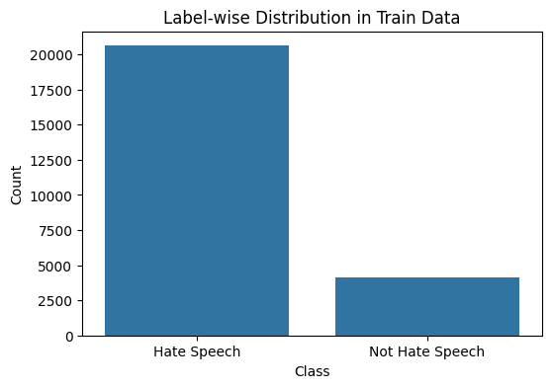
Data Distribution :
Label-wise counts in Data:
Hate speech -20609
Non Hate speech- 4159

Slide 7
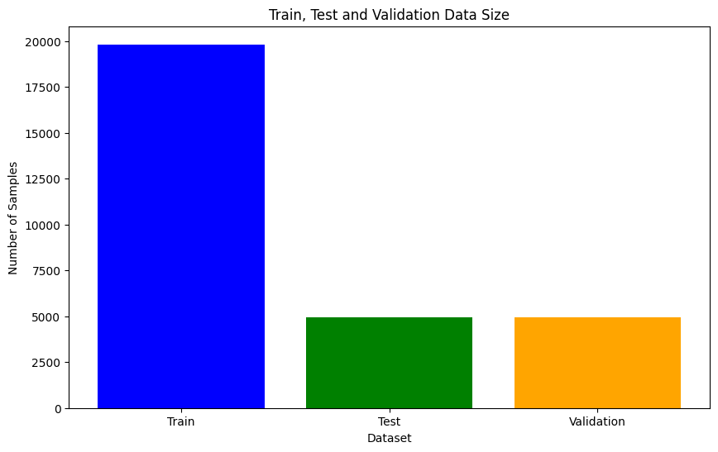
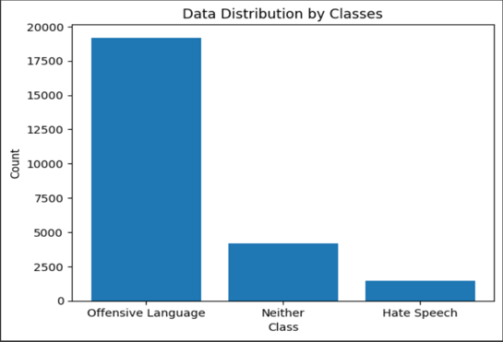
Train, Test and Validation :
Train, Test and Validation Data Size: Class wise Data Distribution :

Slide 8
Data Preprocessing :
Data preprocessing is a process of preparing the raw data and making it suitable for a machine learning model. It is the first and crucial step while creating a machine learning model.
Steps included for Data Preprocessing :
Recategorization: Labeled Hate speech and offensive language as 0, non-hate speech as 1
Handling missing values: Replaced with empty strings
Handling duplicates: Removed duplicates
Handling abbreviations: Replaced with full forms
HTML entity decoding: Decoded HTML entities
Contraction expansion: Expanded contractions
Normalization: Applied normalization to the data

Slide 9
Tokenization and embedding techniques :
Tokenization : Word Tokenization
Word tokenization divides the text into individual words. In this tokenization technique, words are treated as the basic units of meaning.
Embedding techniques :
One – Hot Encoding: One hot encoding is one method of converting data to prepare it for an algorithm and get a better prediction. With one-hot, we convert each categorical value into a new categorical column and assign a binary value of 1 or 0 to those columns. Each integer value is represented as a binary vector.
TF – IDF Encoding : TF-IDF is a numerical statistic that reflects the importance of a word in a document. The TF-IDF algorithm takes into account two main factors: the frequency of a word in a document (TF) and the frequency of the word across all documents in the corpus (IDF).
Word2Vec Encoding : Word2Vec builds word vectors, which are distributed numerical representations of word features. These word features may include words that indicate the context of the specific vocabulary words present individually.

Slide 10
Modeling :
Machine Learning Model
Random Forest Model
Naive Bayes Model
Deep Learning Models
Artificial Neural Network (ANN)
Convolutional Neural Networks (CNN)
Long short-term memory (LSTM)

Slide 11
Finalized Deep Learning Model : Artificial Neural Networks (aNN)
The architecture of ANNs is inspired by the functioning of the human brain, with interconnected neurons transmitting information. ANNs are powerful for capturing complex patterns and relationships in data.
Reasons for choosing Artificial Neural Networks Model:
Flexibility: ANNs can be applied to a wide range of tasks and can learn from diverse types of data.
Adaptability: ANNs can adapt to changing data patterns and improve their performance with more data.
Parallel Processing: ANNs can efficiently process large amounts of data simultaneously, especially when implemented on specialized hardware like GPUs.

Slide 12
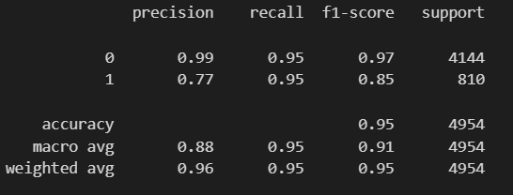
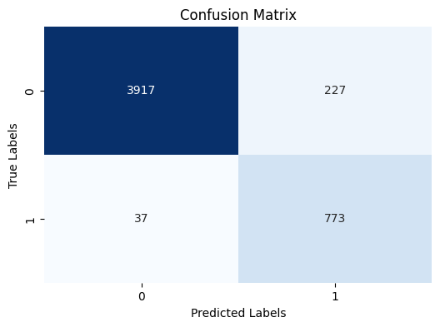
Classification Report and Confusion Matrix :

Slide 13
Evaluation Metrics :
Key Matrix for Evaluation: F1 Score
The F1 score is the harmonic mean of precision and recall, providing a single metric to assess the balance between the two.
Why F1 Score Over Other Parameters
Balance of Precision and Recall: F1 score strikes a balance between precision and recall, crucial for tasks like hate speech detection where both false positives and false negatives matter.
Suitability for Imbalanced Datasets: It equally penalizes errors in rare instances like hate speech in Twitter datasets, offering a fair evaluation across different classes.
F1 Scores Achieved Using Artificial Neural Network
Class 0: 0.97
Class 1: 0.85

Slide 14
THANK YOU

